Slide 1
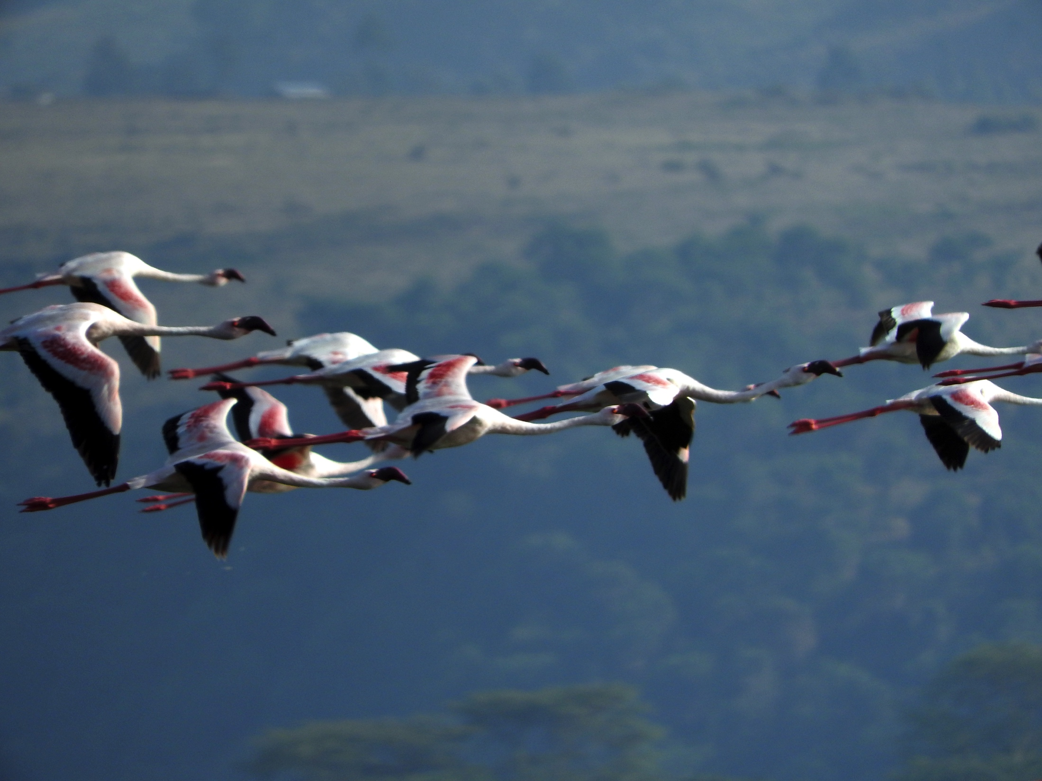
Karibu sana!
Chair’s Welcome TDWG 2015
Cyndy Parr @cydparr

Slide 2
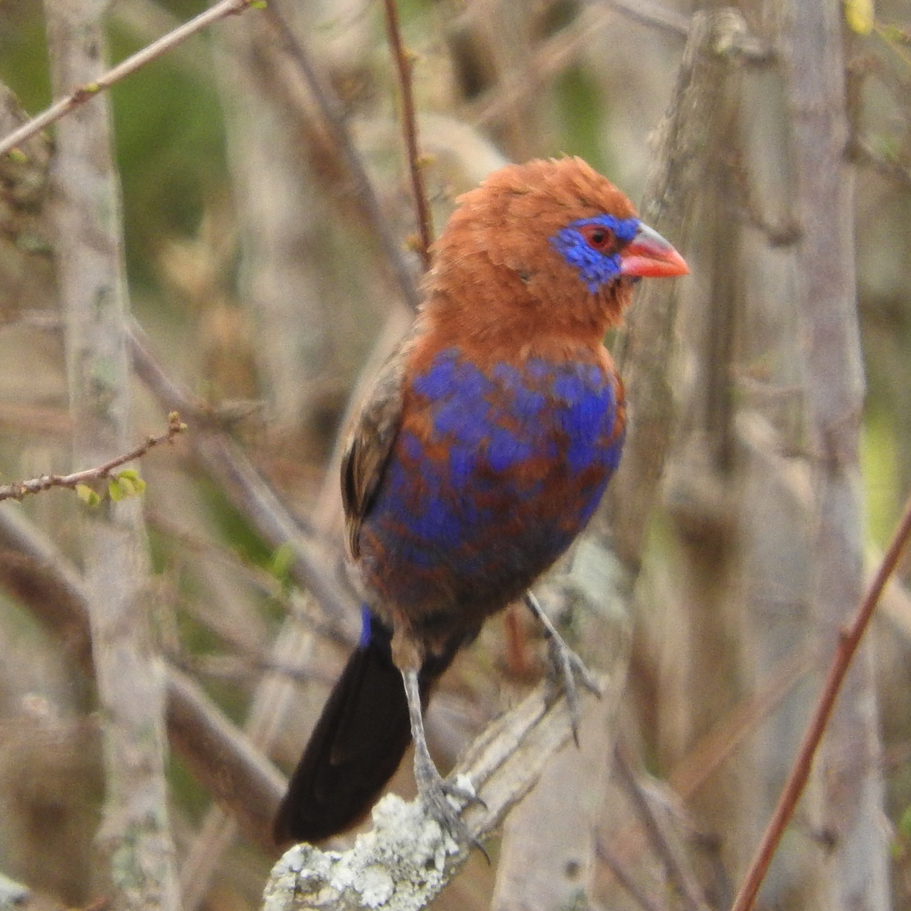
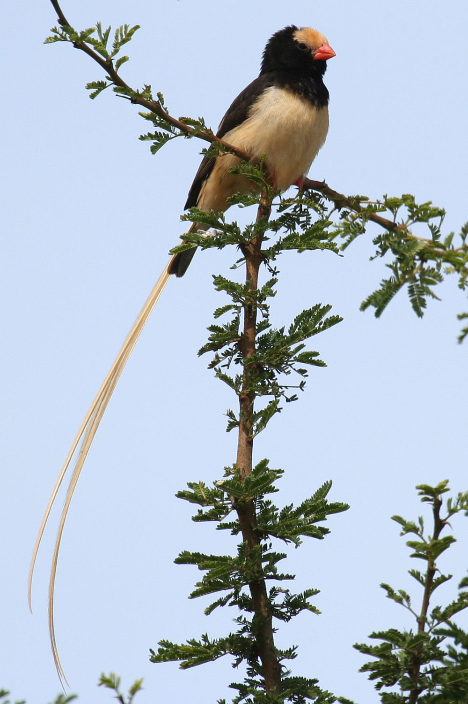
Purple grenadier
host of the brood parasite
Straw-tailed whydah
Credit: KrisMaes

Slide 3


Slide 4
History - Places
1985 | Geneva | Switzerland
1986 | Pittsburgh | USA
1987 | Edinburgh | Scotland
1988 | St Louis | USA
1989 | Las Palmas | Gran Canaria
1990 | Delphi | Greece
1991 | Canberra | Australia
1992 | Xalapa | Mexico
1993 | Washington | USA
1994 | Paris | France
1995 | Madrid | Spain
1996 | Toronto | Canada
1997 | Taipei | Taiwan
1998 | Reading | England
1999 | Harvard | USA
2000 | Frankfurt | Germany
2001 | Sydney | Australia
2002 | Campinas | Brazil
2003 | Lisbon | Portugal
2004 | Christchurch | New Zealand
2005 | St Petersburg | Russia
2006 | St Louis | USA
2007 | Bratislava | Slovakia
2008 | Fremantle | Australia
2009 | Montpellier | France
2010 | Woods Hole | USA
2011 | New Orleans | USA
2012 | Beijing | China
2013 | Florence | Italy
2014 | Jönköping | Sweden

Slide 5
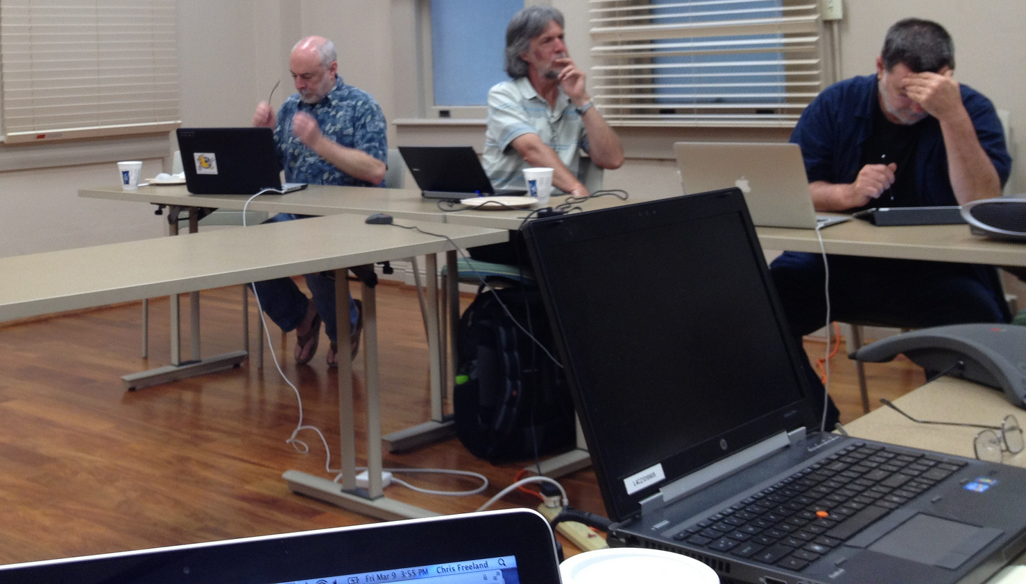
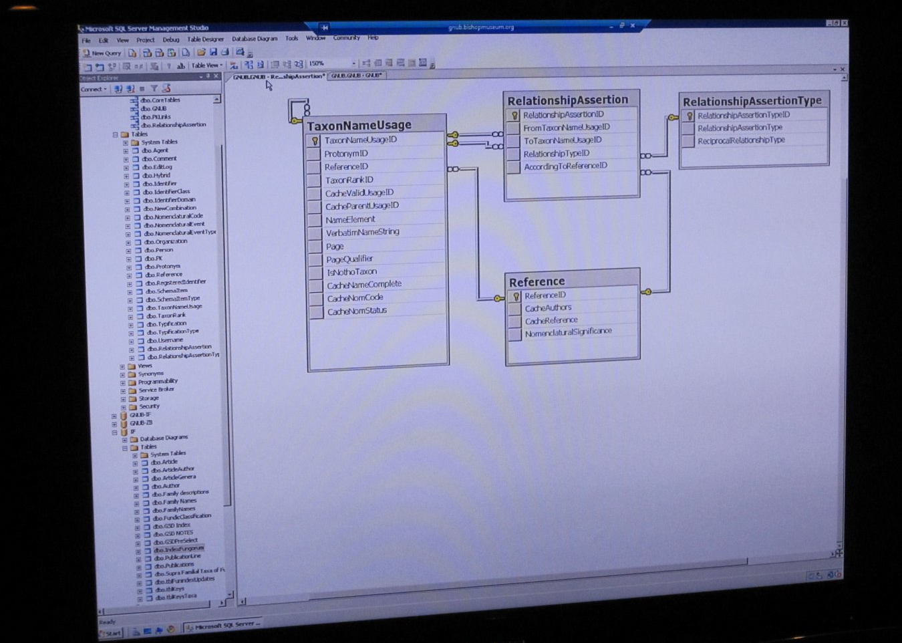
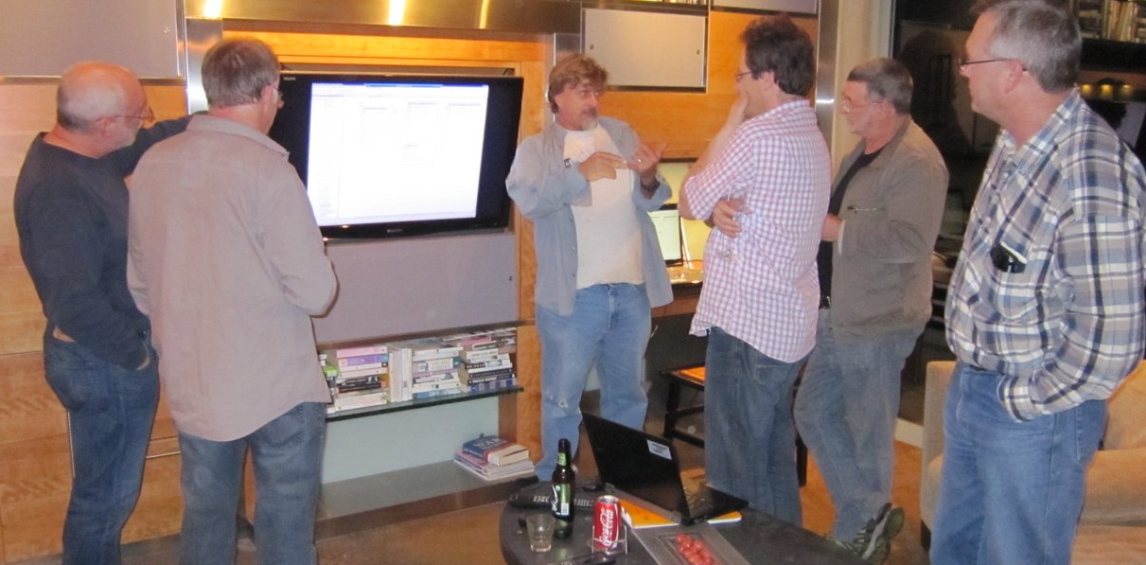
Interest groups and task groups
Credits: Chris Freeland, Stan Blum

Slide 6
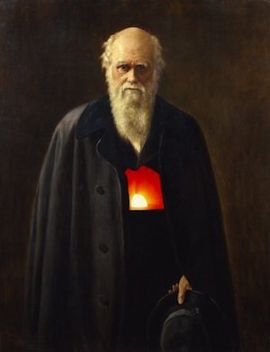
www.tdwg.org/standards/
Technical specs
Data standards
Best practices
Applicability statements
Darwin Core
Biodiversity occurrence data
Credit: Canadensys
Notes:
Includes technical specification, data standards, best practices and applicability statements

Slide 7
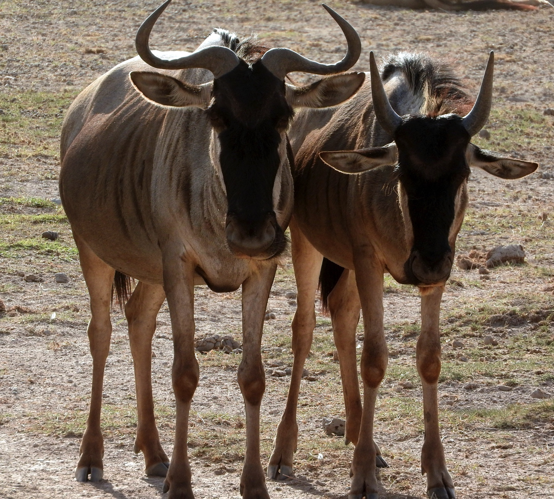


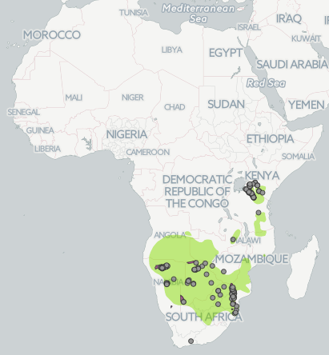
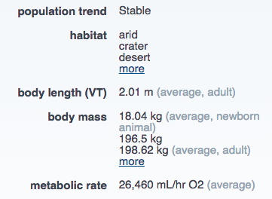
Use cases and applications
TraitBank

Slide 8












Institutional Members

Slide 9
2015 Executive Committee
Chair
Cyndy Parr
Treasurer
William Ulate
Secretary
Patricia Mergen
Africa
Samuel Tsakem
Charles Kahindo
Europe
Peter Desmet
Dimitris Koureas
Asia
Nozomi (James) Ytow
Li-Qiang Ji
Latin America
Antonio Saraiva
Eduardo Dalcin
North America
Bryan Heidorn
James Macklin
Oceania
Paul Flemons
Aaron Wilson
Co-Opt
Tim Roberston
Stan Blum
Gail Kampmeier

Slide 10
Latest developments
TDWG.org web site upgrade essentially complete
All standards now on GitHub
  https://github.com/tdwg
Developing a comprehensive budget process
Improving transparency and responsiveness
Hired a coordinator: Stan Blum
More details at Friday business meeting
Notes:
If you have changes to make to your group presence on the TDWG web

Slide 11
Nominations
All offices are open, anybody can nominate
Nominations on SurveyMonkey
    https://www.surveymonkey.com/r/SG6Y7MB
Eligible members will receive email with link to the SurveyMonkey ballot
One vote per member, one vote per chosen institutional delegate (x 5)
Voting ends three weeks after it begins
Results of the vote will be announced by email

Slide 12

Welcome to TDWG!
Theme: Applications and Data Standards for Sustaining Biodiversity

Slide 13

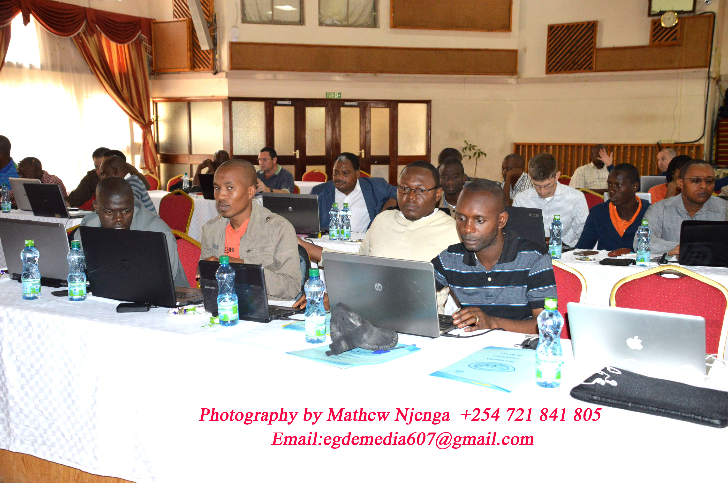

Slide 14
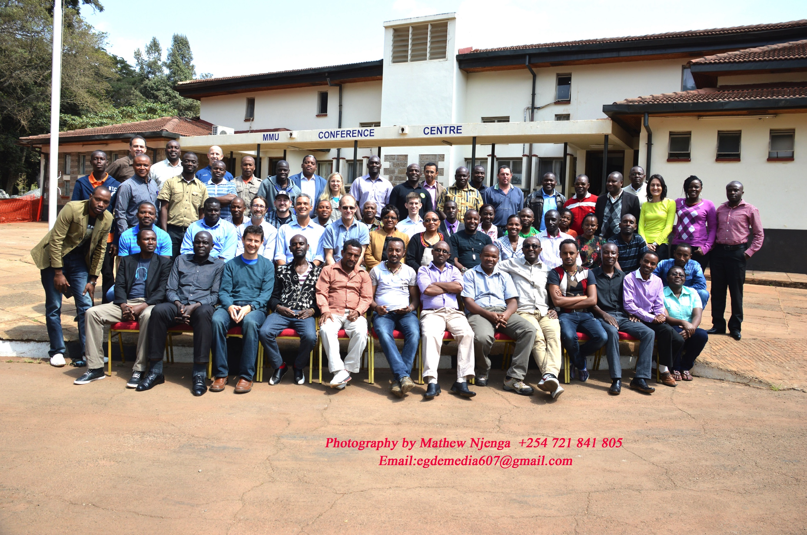
Pre-training: JRS, NSF, and iDigBio

Slide 15
Program
Program is online at mobot.org/tdwg
Program changes at mobot.org/tdwg
Also note changes on printed versions at each room

Slide 16
Program highlights
Pre-meeting training
7 Symposia
5 Contributed paper sessions
127+ Talks
36 Posters
3 Workshops
2+ Interest Groups/Task Groups

Slide 17
Special events
TUESDAY evening Night at the Museum
THURSDAY pm Business meeting
THURSDAY pm Reports from conveners
THURSDAY pm Preview of next meeting
THURSDAY evening Banquet

Slide 18
New special sessions
Newcomers chat in ACACIA TENT
MONDAY 1:30 – 2:00 pm
Birds of a Feather Discussions 8:00 – 9:00 am
TUESDAY, WEDNESDAY,THURSDAY
Collaboration Incubator
WEDNESDAY 09:30 AM – 10:30 AM
Notes:
Open discussion of grant funding organizations and opportunities for collaborative biodiversity informatics research in Sub-Saharan Africa and involving Sub-Saharan Africans.

Slide 19
General information
Registration
Posters
Get slides to your moderator
Meals
Banquet
Excursions

Slide 20
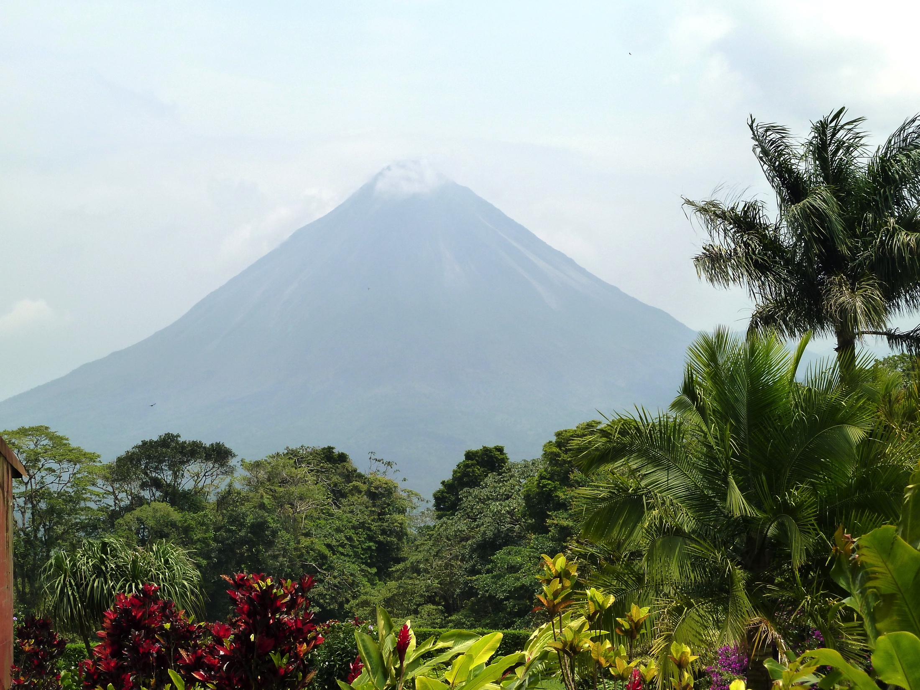
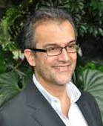
2016 Meeting in Costa Rica
Erick Mata
Presentation on Friday
Erick Mata
Local Host
Program Chair
TBA

Slide 21
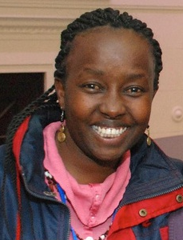

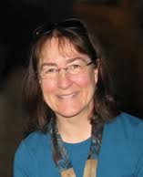
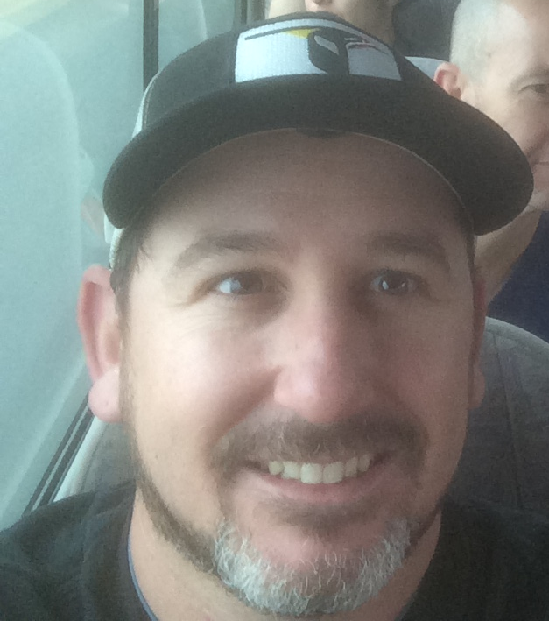
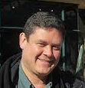
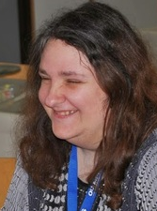
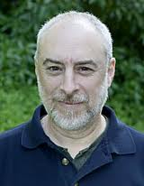
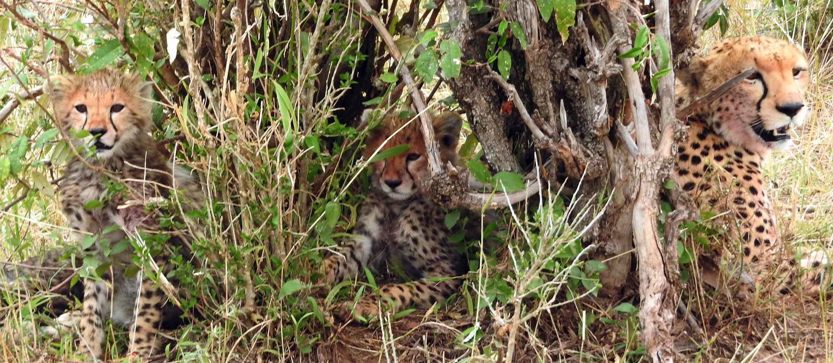
Thanks

