Slide 1

Welcome to TDWG!
Theme: Applications and Data Standards for Sustaining Biodiversity

Slide 2
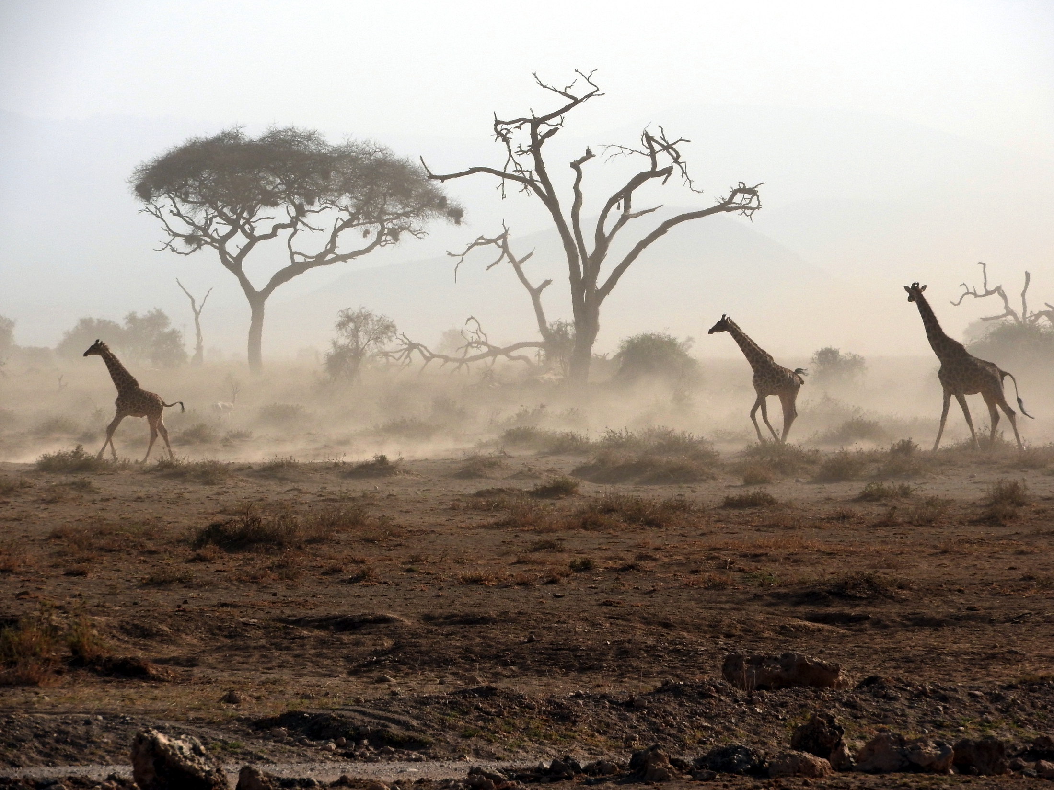

Slide 3
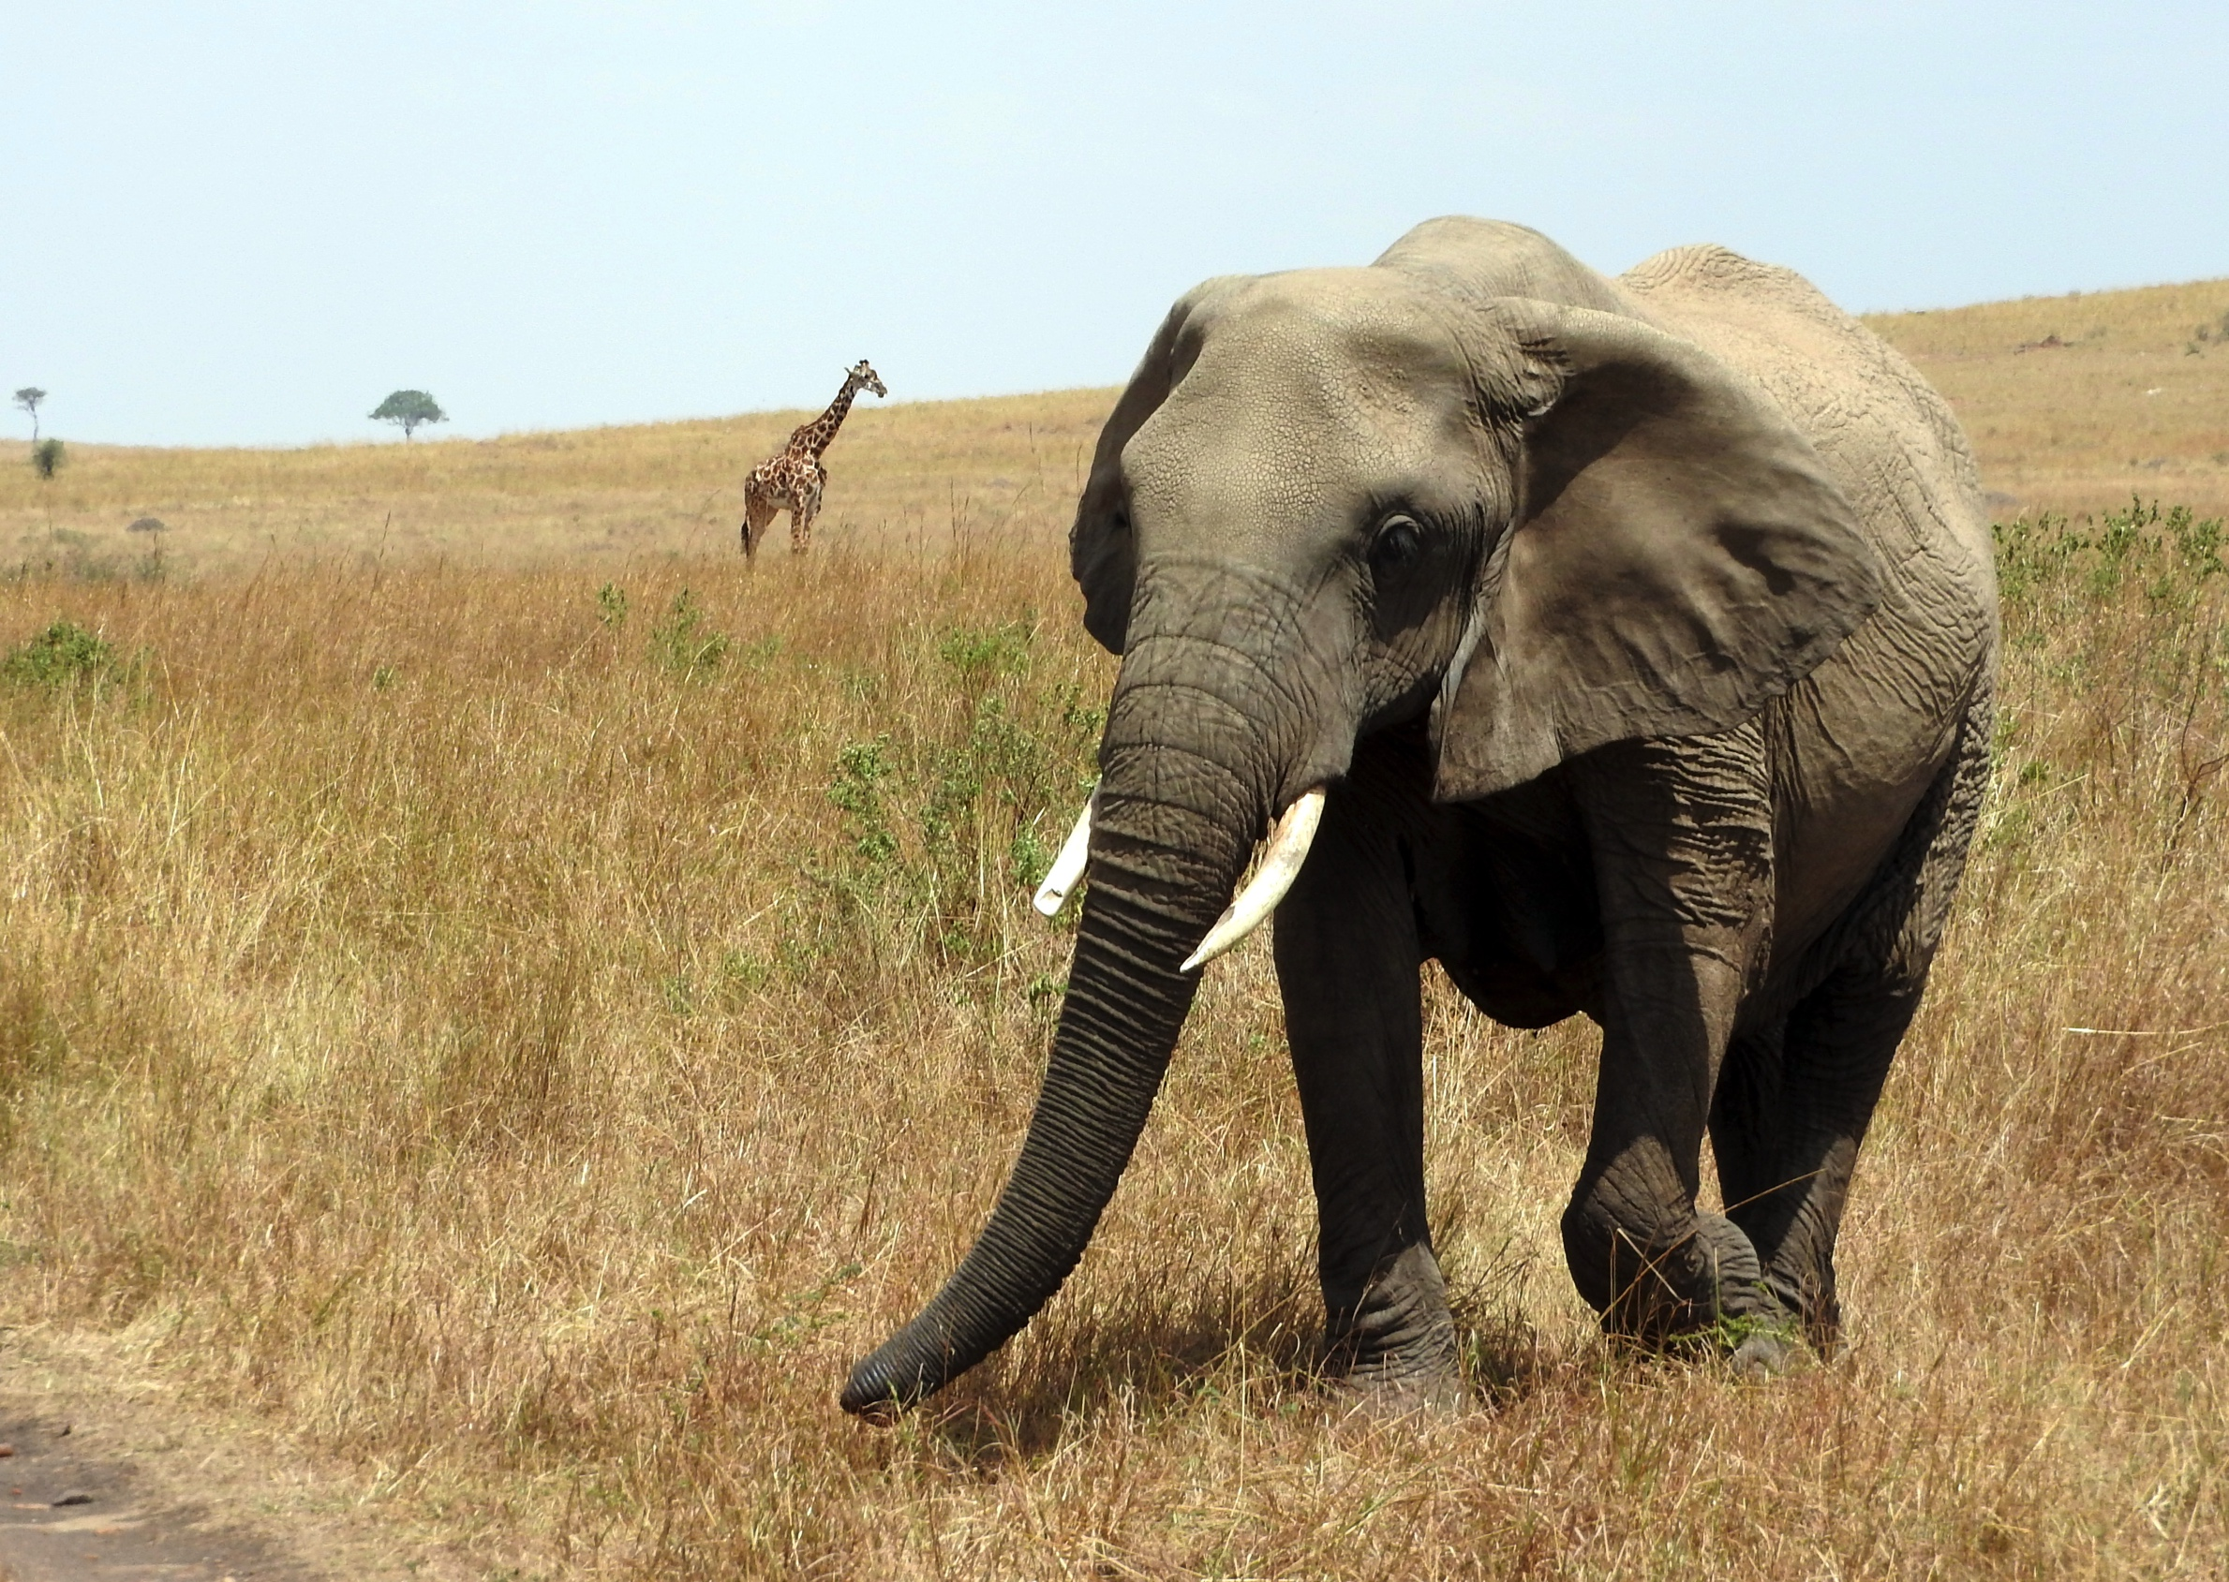

Slide 4






THANKS TO State Institutions
Ministry of Environment and Natural Resources
Ministry of ICT
University of Nairobi

Slide 5
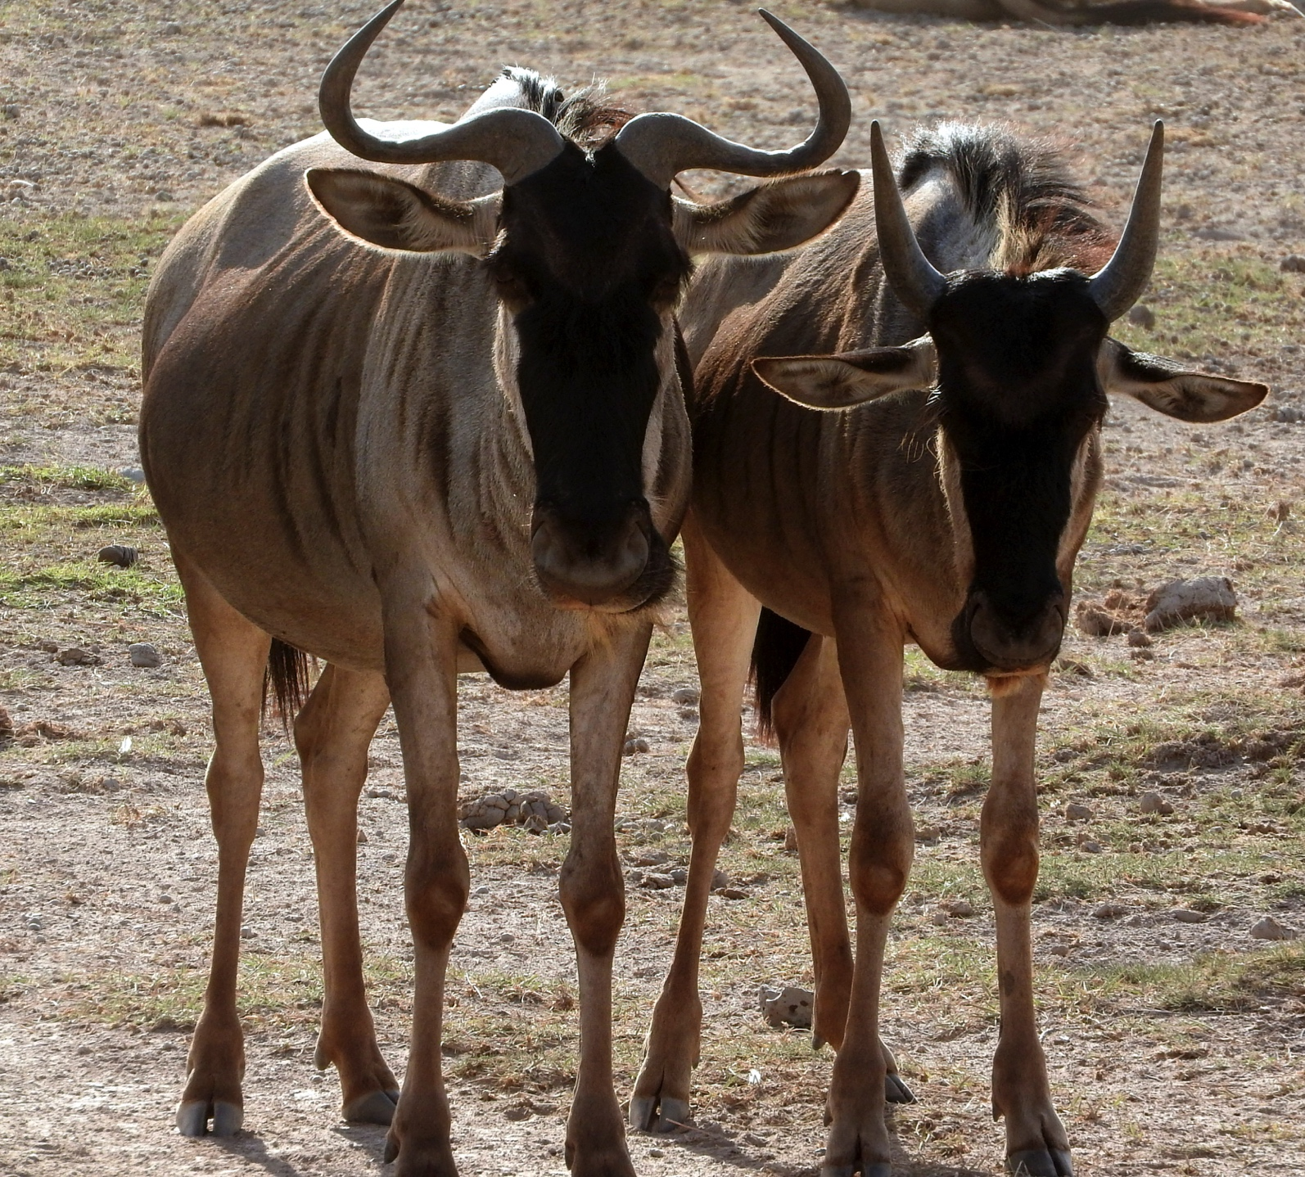

Slide 6
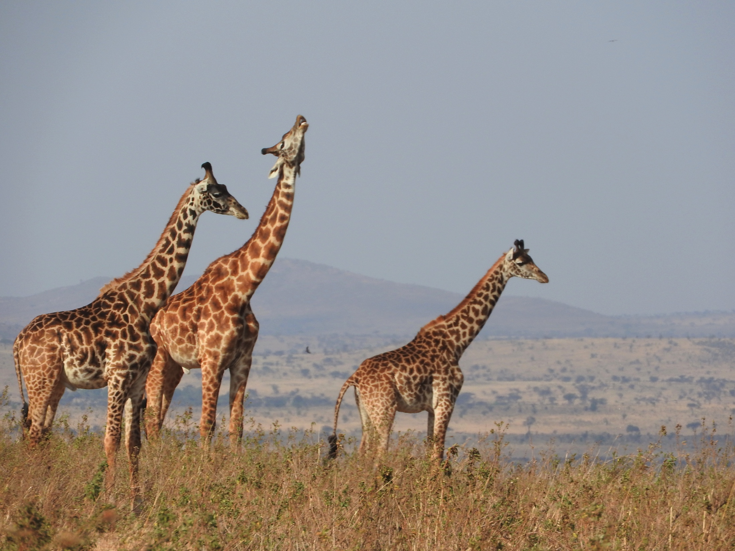

Slide 7
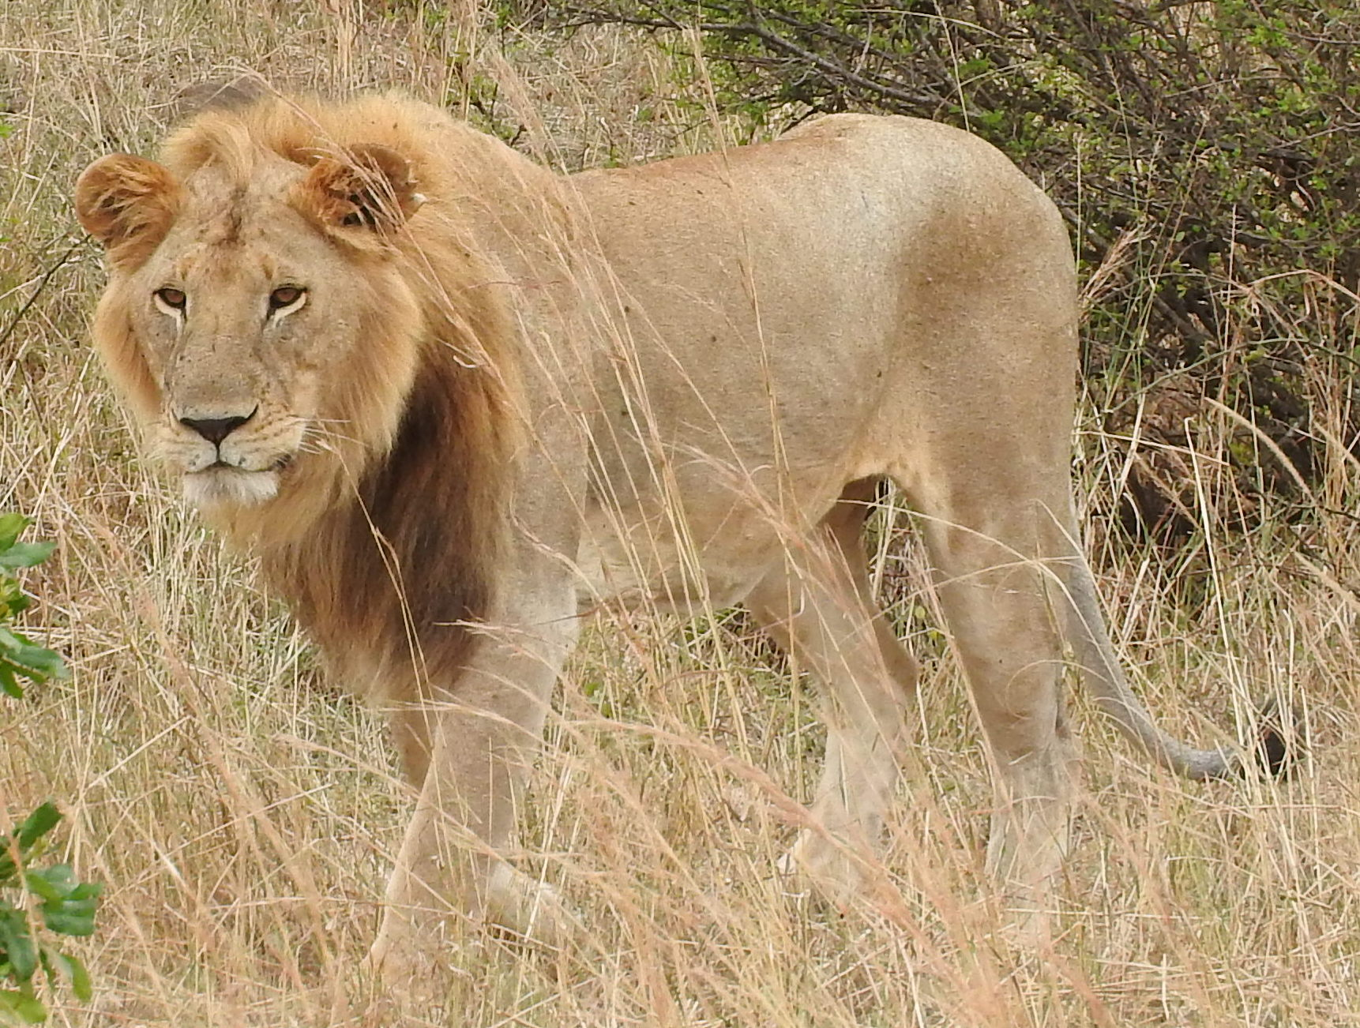

Slide 8




THANKS TO OUR
SPONSORS
Amboseli Conservation Program

Slide 9
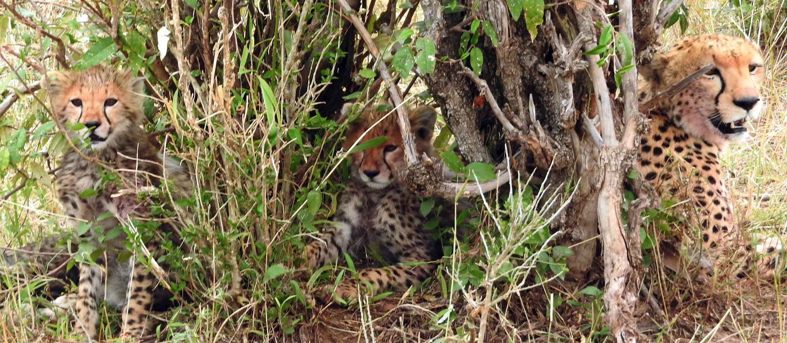

Slide 10
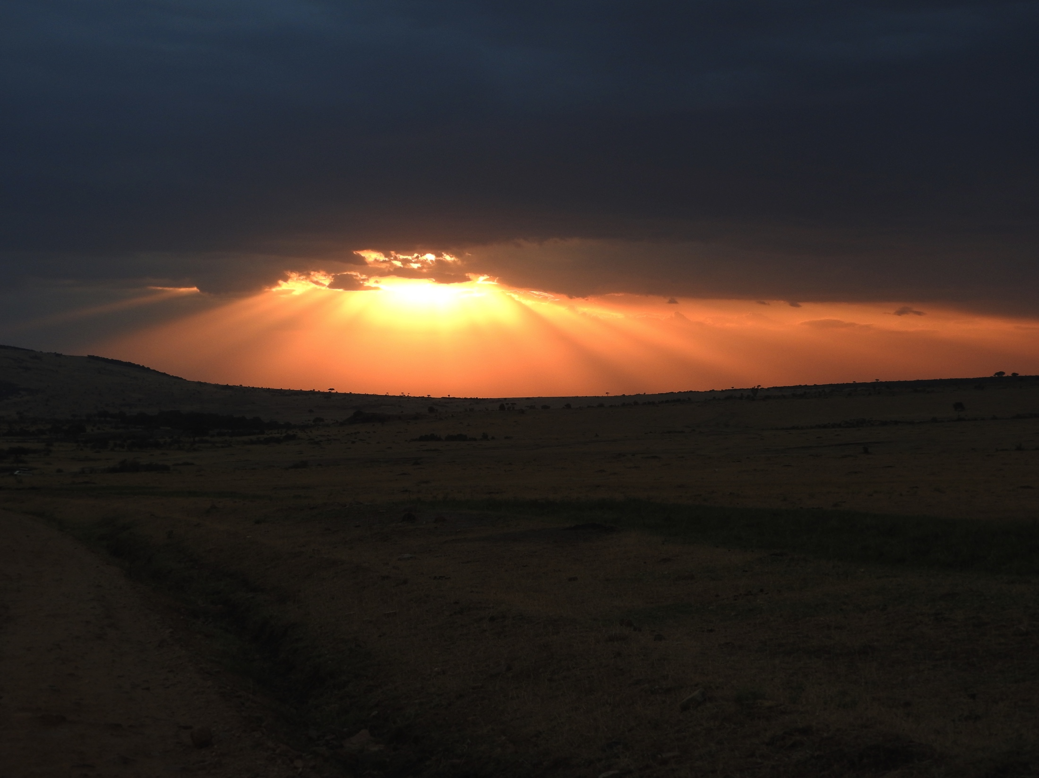

Slide 11
Twitter:
@tdwg
#TDWG15

